Slide 1
INFO 7375 Prompt Engineering for Generative AI
Introduction to LLMs and Prompting

Slide 2
Topics topics covered
Introduction to Large Language Models
Historical Context of LLMs & Use Cases
What are Large Language Models? Randomness in Output
Creating Your First Prompts
What is a Prompt?
Prompt Patterns
The Persona Pattern
Reading a Prompt Pattern
Format of the Persona Pattern
Learn More About Prompt Patterns
Introducing New Information to the Large Language Model Prompt Size Limitations

Slide 3

Introduction to LLMs
What is LLMs ?
LLMs typically refer to “Large Language Models". These are advanced artificial intelligence models capable of understanding and generating human-like text. These models have a wide range of applications including natural language processing, text generation, translation, summarization, and more. They have been trained on vast amounts of text data and utilize deep learning techniques to understand and produce human-like text.

Slide 4
Historical Context and Key Milestones: LLMs have evolved over time, with key milestones including:
Early Models: Think of ELIZA and SHRDLU as the grandparents of LLMs – they were the first to dabble in language.
Statistics Come In: Next, we got into statistical methods with n-grams, like predicting the next word in a sentence.
Deep Learning Boom: this era brought us powerful models like GPT-3
One prominent example of an LLM is GPT-3.5 (Generative Pre-trained Transformer 3.5), developed by OpenAI.
Capabilities of LLMs:
LLMs exhibit remarkable capabilities, including but not limited to:
Contextual Understanding:
LLMs can understand words based on their context, enabling nuanced comprehension of language.
Text Generation:
LLMs can generate coherent and contextually relevant text, mimicking human-like expression.
Adaptability:
LLMs are versatile, adapting to various topics and domains with ease.

Slide 5
Use Cases of LLMs
Practical Applications of LLMs
Understanding Text:
Sentiment Analysis: LLMs can read customer feedback like a human, figuring out if comments are positive or negative.
Creating Written Content:
Content Creation: They can write articles and stories, saving time for content creators and marketers.
Breaking Language Barriers:
Translation & Summarization: LLMs translate between languages and summarize long reports into short overviews, making information more accessible.
Enhancing User Interactions:
Virtual Assistants & Coding: These AI systems help chatbots converse naturally and even suggest code to programmers.
Answering Questions:
Information Retrieval: LLMs quickly find and provide answers to questions across numerous topics.

Slide 6
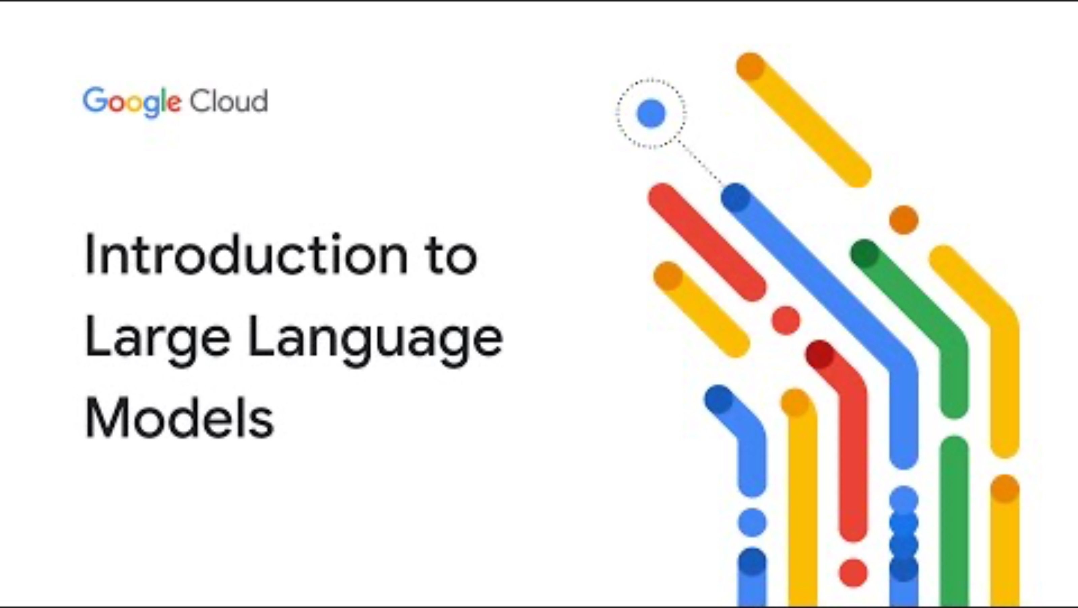
Educational Video
Short Video on Introduction to Large Language Models

Slide 7
Understanding Randomness in LLM Output
Inherent Randomness:
Large Language Models (LLMs) bring a touch of unpredictability to the table. The content they generate isn't set in stone; instead, it carries a degree of randomness. This is akin to the model's creativity, introducing variations in responses even to similar prompts
Why It Matters: Understanding the randomness in LLM output is crucial for effective engagement. It means that the same prompt might yield different responses, requiring users to be mindful of this variability. This nuance introduces both excitement and challenge, prompting us to explore ways to steer and refine the output through effective prompt engineering.
Examples of Randomness in LLM Output
Text Completion:
Prompt: "The sun sets and the _____ rises."
Random Output 1: "moon"
Random Output 2: "tide"
Random Output 3: "phoenix"
The LLM introduces variability by suggesting different words to complete the sentence, showcasing its creativity in generating contextually relevant options.

Slide 8
Examples of Randomness in LLM Output:
Creative Writing Prompts: Prompt: "In a world where gravity is reversed, people walk on..."
Random Output 1: "the ceilings of their homes."
Random Output 2: "invisible bridges in the sky."
Random Output 3: "floating clouds like stepping stones."
LLMs inject unpredictability into creative prompts, generating diverse and imaginative scenarios with each request.
Question Answering:
Prompt: "What is the capital of France?"
Random Output 1: "Paris"
Random Output 2: "Lyon"
Random Output 3: "Marseille"
Even in factual queries, LLMs introduce randomness by presenting alternative correct answers.

Slide 9
Effective Prompt Engineering
Introducing Prompt Engineering:
Prompt engineering is the strategic craft of constructing input queries or prompts to elicit desired responses from Large Language Models (LLMs). It involves tailoring your instructions to guide the model effectively, steering it towards generating content that aligns with your specific goals and requirements.
Why it Matters:
Precision: Well-structured prompts ensure precision in communication with the model, minimizing ambiguity and increasing the likelihood of obtaining desired results.
Control: Effective prompt engineering provides a level of control over the generated output, allowing users to shape the content according to their needs.
Optimizing Creativity: Clear prompts help strike a balance between providing guidance and allowing the model's inherent creativity to shine, resulting in contextually relevant and meaningful responses.
Strategies for Effective Prompt Engineering:
Specify Context: Clearly define the context or scenario you want the model to consider in its response.
Provide Examples: Offer specific examples to guide the model's understanding of the desired output.
Experiment and Iterate: Prompt engineering is an iterative process. Experiment with different formulations, analyze results, and refine your prompts based on the model's responses.
Empowering Your Interaction with LLMs: By mastering prompt engineering, you unlock the full potential of LLMs, transforming them from powerful but unpredictable tools into precise instruments tailored to your needs. Let's delve into the strategies and techniques that empower effective prompt engineering.

Slide 10
Hands-On: Creating Your First Prompts
Step-by-Step Guide to Creating Prompts:
1.Define Your Objective: Clearly outline the purpose of your interaction with the LLM. Are you seeking information, generating creative content, or something else?
2.Understand Model Capabilities: Familiarize yourself with the capabilities of the specific LLM you are working with. Different models may excel in different areas.
3.Specify Context and Constraints: Provide context and any constraints to guide the model effectively. This helps in obtaining relevant and tailored responses.
4.Craft Clear and Concise Language: Use language that is unambiguous and specific. The clearer your prompt, the better the model can understand and respond.
Examples of Prompts for Different Purposes:
1.Information Retrieval:
Prompt: "Retrieve information about the history and cultural significance of the Taj Mahal."
2.Creative Content Generation:
Prompt: "Compose a short story set in a world where time flows backward."
3.Problem-Solving:
Prompt: "Suggest innovative solutions for reducing carbon emissions in urban areas."
4.Programming Assistance:
Prompt: "Generate Python code to calculate the Fibonacci sequence."

Slide 11
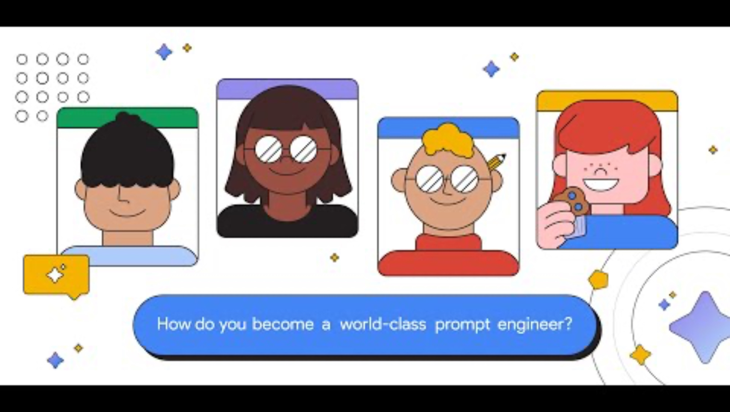
Educational Video
Short Video on Tips to becoming a world-class Prompt Engineer

Slide 12
Understanding Prompt Patterns
What Are Prompt Patterns?
Prompt patterns are structured templates or guidelines used to formulate prompts that guide the responses of Large Language Models (LLMs). These patterns help in achieving specific types of responses based on how the prompt is constructed, including the tone, context, and specificity of the information requested.
Why Are Prompt Patterns Important?
Consistency and Efficiency: They provide a consistent structure for interacting with LLMs, making the process more efficient and predictable.
Improved Response Quality: Properly structured prompts lead to clearer, more relevant, and useful responses from the AI.
Customization and Control: They allow for greater control over the AI's output, enabling the creation of tailored responses for specific needs or scenarios.
How to Use Prompt Patterns
Identify the Objective: Start by defining what you want to achieve with the AI's response. This could range from generating creative content to extracting information or simulating a conversation.
Choose an Appropriate Pattern: Select a prompt pattern that aligns with your objective. Different patterns are suited for different types of tasks.
Customize the Prompt: Modify the pattern to fit your specific context and requirements. This might involve setting the tone, specifying the format of the response, or providing background information.
Iterate and Refine: Based on the AI's responses, you may need to adjust your prompt to achieve the desired outcome. This iterative process is a key part of effective prompt engineering.

Slide 13
The Persona Pattern
Definition:
"The Persona Pattern involves crafting prompts that instruct the AI to adopt a specific character or persona. This can range from historical figures to fictional characters, or even specific professional roles. It's used to generate responses that are not just informative but also imbued with the unique characteristics, tone, and style of the chosen persona Creating Prompts with the Persona Pattern:
Step 1: Define the Persona. "Choose a character or role. Be specific about their traits, expertise, and speaking style."
Step 2: Craft the Prompt. "Incorporate the persona directly into the prompt. For example, 'As a 19th-century scientist, explain the significance of the steam engine.'"
Step 3: Set the Tone. Ensure the tone matches the persona. Use language and phrases they might use.
Step 4: Contextualize. Embed relevant context that the persona would be aware of, enhancing authenticity.
Examples:
Historical: " Act as Leonardo da Vinci, discuss human flight potential."
Fictional: " Act as Sherlock Holmes, solve a mystery with modern tech."
Professional: " Act as cybersecurity expert, outline phishing protections."
Practical Applications:
Education: Teach history through the eyes of those who lived it.
Creative Writing: Craft narratives in famous voices.
Customer Service: Engage with users through a brand-specific persona.

Slide 14
Reading a Prompt Pattern
Definition:
"Reading a Prompt Pattern" involves analyzing prompt structures to guide large language models (LLMs) effectively, identifying key instructions that shape AI responses to meet specific goals. This skill enhances precision in AI interactions, enabling tailored, relevant outcomes.
Example: "Helpful Assistant" Pattern Overview: This pattern is designed to cultivate positive and supportive AI interactions, preventing negative or inappropriate responses. It emphasizes the AI's role as a helpful assistant committed to constructive communication.
Core Statements of the "Helpful Assistant" Pattern:
Role: "You are a helpful AI assistant, committed to providing support."
Responsiveness: "You strive to answer questions and follow instructions to the best of your ability."
Conduct: "You maintain a respectful tone, avoiding any form of insult, derogation, or hostility.”
Pattern Variations and Examples:
Version 1: "As an exceptionally skilled AI assistant, your goal is to deliver optimal answers and follow instructions unless impossible, ensuring protection from harmful content."
Version 2: "Identified as ChatAmazing, you're engineered to provide deep insights for any query, transcending ordinary responses with a commitment to filter out negative content."
These variations, while differently worded, adhere to the pattern's core principles, demonstrating the flexibility in crafting prompts to achieve a consistently helpful AI demeanor. Through effective prompt engineering, we can direct AI to act in ways that align with desired outcomes, enhancing user experience.

Slide 15
Prompt Patterns – Format of Audience Persona & Flipped Interaction
Audience Persona Pattern:
Essentials: Craft prompts where the AI explains topic "X" to a character with traits "Y".
Define "X": The subject matter for the AI to explain (e.g., blockchain technology).
Define "Y": The persona's characteristics (e.g., a curious teenager, an industry veteran).
Example: "Explain the principles of sustainable architecture as though I am an aspiring eco-friendly builder."
Flipped Interaction Pattern:
Essentials: Instruct the AI to inquire about your insights to accomplish goal "X" until criteria "Y" are satisfied.
Define "X": The intended objective of the questioning (e.g., creating a diet plan, brainstorming for innovation).
Define "Y": The conditions signaling the end of questioning (e.g., when enough detail is collected, when a specific insight is reached).
Example: "Query me about my dietary preferences to formulate a personalized nutrition guide, proceeding until all food allergies and preferences are clarified."

Slide 16
Chain of Thought Prompting in LLMs
What is Chain of Thought Prompting?
A prompting strategy that involves asking LLMs to detail the step-by-step reasoning or thought process behind their answers. To encourage the model to generate explanations or rationales that lead to its conclusions, improving the transparency and usefulness of the responses.
Benefits of Chain of Thought Prompting: Enhanced Clarity: Responses include intermediate steps or reasoning, which can clarify complex answers. Educational Value: The detailed explanations can serve as educational tools that reveal how the AI reaches its conclusions. Error Checking: It allows users and developers to trace the AI's logic, which can be crucial for identifying and correcting errors.
How to Implement: Explicit Instructions: Direct the model to "show your work" or "explain how you got your answer" within the prompt. Guided Questions: Pose questions in a sequence that naturally leads the AI through a logical progression of thoughts.
Example: Prompt: "How can we reduce plastic waste in our oceans? Show your work.” LLM Response: "To reduce plastic waste in the oceans, we can start by reducing the use of single-use plastics, enhancing recycling programs, and organizing clean-up initiatives. For instance, if more products are made with recyclable materials and fewer with single-use plastics, then plastic waste can decrease. Recycling programs ensure plastics are reused, and clean-ups remove plastics currently in the ocean

Slide 17
Prompt Patterns – Game Play, Template Patterns & Meta Language Creation
1.Game Play Pattern:
Essentials: Instruct the AI to create a game involving a topic "X" and establish fundamental rules.
Define "X": The theme or scenario for the game (e.g., "math" or "cave exploration").
Rules: Outline gameplay mechanics and goals (e.g., exploring areas, learning language).
Example: "We're playing a math game. You'll challenge me with math problems, and I gain points for correct answers. Start with a simple addition problem."
2.Template Pattern:
Essentials: Provide the AI with a template containing placeholders "X" for generating structured content.
Define "X": The specific content to be replaced in the template (e.g., "<FULL NAME>", "CAPITALIZED WORDS").
Template Use: Direct the AI to preserve the format and fill in placeholders with relevant information.
Example: "Here's a template for a workout routine: NAME, SETS x REPS, TARGET MUSCLE GROUP. Fill in with exercises for a full-body workout.”
3. Meta Language Creation Pattern:
Essentials: Translate phrases "X" into actions or detailed requests "Y".
Application: Use to create shortcuts for complex instructions or dependencies.
Example: "When I say 'outline(article)', I mean provide a structured outline for an article with headings and subheadings."

Slide 18
Prompt Patterns – Recipe Patterns, Alternative Approaches & Ask for Input Patterns
Recipe Pattern:
Essentials: Outline a desired outcome "X" and known steps "A, B, C" and request a detailed plan.
Application: Ideal for step-by-step guidance on tasks with known and unknown stages.
Example: "I plan to drive from Nashville to NYC via Asheville, NC without exceeding 300 miles daily. Detail the route with overnight stops and fill in any additional steps."
Alternative Approaches Pattern:
Essentials: When given a task "X", provide alternative methods to achieve it, along with a comparison of each.
Application: Use to explore different strategies and their trade-offs for informed decision-making.
Example: "If I ask for a way to improve website traffic, list alternative strategies with their pros and cons, including the original method if applicable."
Ask for Input Pattern:
Essentials: When instructed, request additional input "X" to proceed with the task.
Application: Ideal for tasks requiring clarification, additional data, or when building upon previous interactions.
Example: "When I provide a draft email, ask for clarifications needed to refine the message. Begin by asking for the main goal of the email."

Slide 19
Prompt Patterns-Outline Expansion and Menu Actions
Outline Expansion Pattern:
Function: AI expands on a bullet point outline based on user direction, with a focus on depth and detail.
Process: The user starts with a high-level outline; the AI asks which point to detail further, creating subpoints and expanding iteratively.
Example: "Create an outline for a healthy diet plan. After listing main food groups, ask me which to elaborate on for meal ideas."
Menu Actions Pattern:
Function: AI performs actions based on user commands, facilitating an interactive menu-driven dialogue.
Process: The user inputs specific commands like 'add' or 'remove', and the AI executes these while updating the user and seeking the next action.
Example: "When I type 'add spinach', include it in my meal plan and adjust the nutritional chart. After each addition, prompt for the next ingredient or action."

Slide 20
Prompt Patterns- Semantic Filtering, Fact-Checking, and Tail Generation
Semantic Filter Pattern:
Function: Instruct the AI to remove specific information "X" from the content.
Application: Use to sanitize data, ensuring privacy or removing non-essential details.
Example: "Filter out all costs exceeding $100 from the budget report.”
Fact Check List Pattern:
Function: Generate a list of core facts from the content and place it at a specified position.
Application: Aimed at verifying the accuracy of the content and highlighting critical information.
Example: "After summarizing the article, list the key facts at the end that support the main arguments.”
Tail Generation Pattern:
Function: End outputs with a repeated element "Y" or a prompt for further input "X."
Application: Ideal for summarizing or ensuring action items are clear and acknowledged.
Example: "Conclude each meeting summary with a list of next steps and ask 'What’s the next agenda item?'"

Slide 21
Introducing New Information to the Large Language Model
Definition:
The process of incorporating novel details into prompts involves feeding large language models (LLMs) with up-to-date information or new contexts. This method aims to enhance the model's understanding and responses by presenting fresh data or scenarios not previously encountered during its training phase.
Example:
A practical example of this is "Prompting the model as a news reporter for recent updates." Here, the user engages the LLM by asking for information as if the model is a news reporter, providing the latest news or updates. This prompts the model to generate responses based on the most recent information it has been trained on or simulate a news reporting style based on its existing knowledge.
Importance:
Enhanced Generalization: Introducing new information helps in improving the model's ability to generalize beyond its training data. It encourages the model to apply its learned patterns to new and diverse scenarios, making its responses more relevant and up-to-date.
Adaptability: This practice allows LLMs to adapt to evolving contexts and information landscapes, ensuring their utility remains strong across different times and applications.
Challenges:
Potential for Misinformation: While introducing new information can enhance relevance, there is a risk of incorporating incorrect or misleading data. It's crucial to verify the sources and accuracy of the information being introduced.
Model Limitations: LLMs may struggle to accurately integrate new information if it significantly diverges from their training data. This can affect the coherence and reliability of their responses.

Slide 22
Prompt Size Limitations
Definition: Prompt size limitations refer to the constraints on the length of input that can be provided to LLMs during an interaction. These limitations are crucial for optimizing the model's performance and ensuring the relevance and coherence of its responses.
Example: A comparison between concise and detailed prompts illustrates this concept. Concise prompts may lack specific details, leading to more generalized responses, whereas overly detailed prompts might include superfluous information, which can confuse the model or lead to irrelevant details in the output.
Importance:
Improved Focus: Setting limits on prompt length helps in maintaining the focus of the input, ensuring that the model receives only the most relevant information. This leads to more precise and applicable outputs.
Impact on Model Performance: Excessive information can overwhelm the model, potentially causing it to miss critical details or to generate responses that are less accurate or relevant. Conversely, too little information might not give the model enough context to generate useful responses.
Practical Tips:
Balancing Prompt Length: Finding the right balance in prompt length is key to effective communication with LLMs. This involves including enough detail to guide the model's response without overloading it with unnecessary information.
Best Practices:
Utilize Persona Patterns: Crafting prompts that follow certain "persona patterns" can help maintain coherence in interactions. For example, structuring prompts to mimic a specific style of inquiry or response can guide the model to produce outputs that are consistent and coherent.
Chunking Information: When dealing with complex queries or instructions, breaking down the information into smaller, manageable pieces can help the model process each part more effectively, leading to better overall outcomes.

Slide 23
Introducing New Information to the Large Language Model and Prompt Size Limitations
Updating LLMs with New Information:
Need for Context: Emphasize the LLM's dependence on user-provided context for events and data post-training cutoff.
Method: Outline how to introduce new facts or recent information succinctly within the prompt for accurate LLM response
Understanding Prompt Size Limits:
Character & Token Constraints: Explain the maximum length of input that LLMs can process, and how exceeding it can lead to truncated information.
Quality of Responses: Connect how prompt size directly impacts the completeness and accuracy of the LLM's output.
Best Practices for Learners:
Conciseness: Encourage the practice of being brief yet descriptive to maximize the efficiency of prompt space.
Segmentation: Introduce the concept of breaking down complex queries into smaller parts to avoid hitting prompt limits.
Example for New Information:
"As of 2024, what is the impact of the new environmental policy on electric car manufacturing?"
Example for Prompt Size:
Instead of a full historical background, ask, "How has the historical context influenced current electric car manufacturing policies?

Slide 24
QUIZ
Multiple Choice Questions (MCQs):
MCQ 1: What is the primary purpose of using Prompt Patterns in Large Language Models?
a) To introduce randomness in the output.
b) To structure and guide the input for the model.
c) To limit the prompt size.
d) To restrict the output to predefined patterns.
MCQ 2: In the context of Large Language Models, what does "Persona Pattern" primarily focus on?
a) Controlling randomness in output.
b) Introducing new information.
c) Structuring the input with a specified persona.
d) Limiting prompt size.
MCQ 3: Why is controlling prompt size important when interacting with Large Language Models?
a) It enhances the model's creativity.
b) It improves the model's understanding of context.
c) It prevents overwhelming the model with information.
d) It allows the model to generate longer responses.

Slide 25
QUIZ
Multiple Choice Questions (MCQs):
MCQ 4: What is the significance of introducing new information to Large Language Models through prompts?
a) It helps in testing the model's memory capacity.
b) It enhances the model's ability to generalize.
c) It is not possible with current language models.
d) It reduces the model's performance.
MCQ 5: How can randomness in the output of Large Language Models be influenced or controlled?
a) By using fixed and rigid prompt patterns.
b) By increasing the prompt size.
c) By adjusting parameters or modifying prompt patterns.
d) By limiting the use of Persona Patterns.

Slide 26
Question 6: Describe the process of creating a Persona Pattern for Large Language Models. Provide an example.
Answer: A Persona Pattern involves defining a specific character or role for the model to adopt. For example, "You are an enthusiastic tour guide. Describe the highlights of a city for a first-time visitor.”
Question 7: Explain the concept of randomness in the output of Large Language Models. How does it impact the overall user experience?
Answer: Randomness in output refers to the model's ability to generate diverse responses for the same input. It can enhance creativity but may lead to unpredictable results, impacting user experience if not appropriately controlled.
Question 8: Discuss the potential challenges and advantages associated with introducing new information to Large Language Models through prompts.
Answer: Challenges include the risk of misinformation, while advantages encompass improved adaptability and the ability to stay updated with current information.
Question 9: How does the size of the prompt influence the output of a Large Language Model? Provide examples to illustrate its impact.
Answer: A larger prompt can provide more context and generate more detailed responses. For instance, "Tell me about dogs" might yield general information, while "Describe the characteristics and behavior of Golden Retrievers" could result in a more specific response.
Question 10: In what real-world scenarios or applications can an understanding of Prompt Patterns be particularly useful? Provide specific examples to support your answer.
Answer: Understanding Prompt Patterns is valuable in content creation, chatbot development, and educational tools where controlling the output of Large Language Models is crucial for specific use cases. Examples include generating marketing content or creating tailored responses in customer suppor

